Slide 1
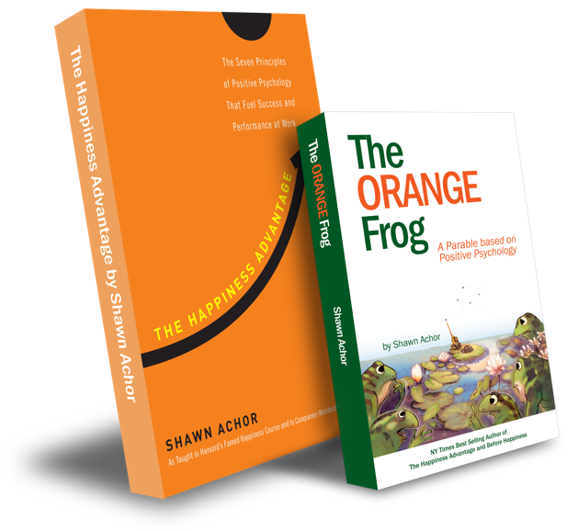
The Happiness Advantage
and
The Orange Frog
By Shawn Achor

Slide 2
Elementary Week Three

Slide 3
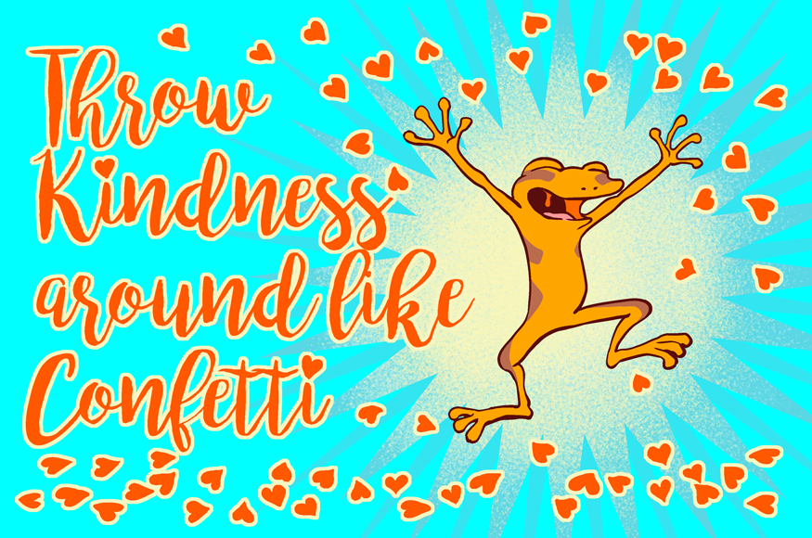
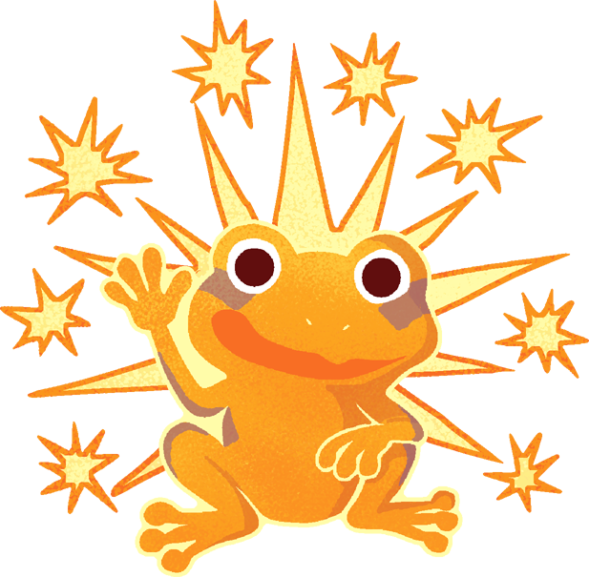
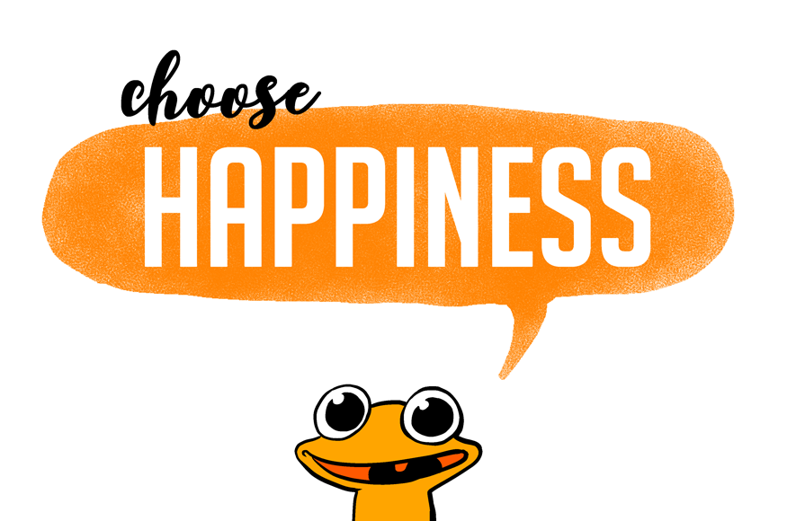
The Orange Frog
Learning Objective:
I can think and act like Spark
I will discuss what it means to handle situations like spark
Notes:
Standard:
Essential Concept and/or Skill: Communicate and work productively with others emphasizing collaboration and cultural awareness to produce quality work.
Interact positively as a team member.
Cooperate with others in a group setting.
Generate ideas with group members.
Are active listeners.
Read and understand information in a variety of forms.
Express ideas.
Skill:
Active listening, express ideas
Allow Spark to read pages 13-18 for the students or read to them.
https://www.orangefrogschools.com/elementary/ofkidsbook

Slide 4
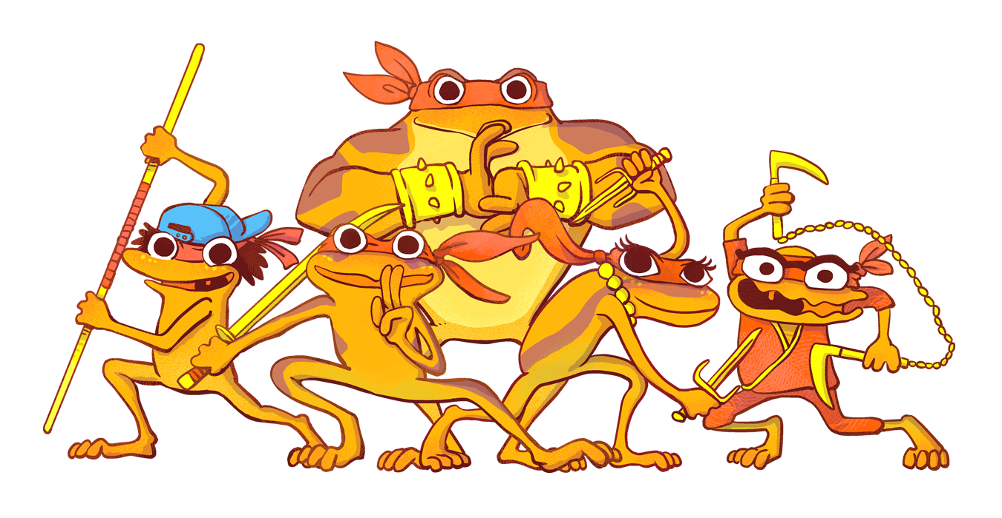
Skills
Interact positively as a team member.
Cooperate with others in a group setting.
Generate ideas with group members.
Are active listeners.
Read and understand information in a variety of forms.
Express ideas.

Slide 5
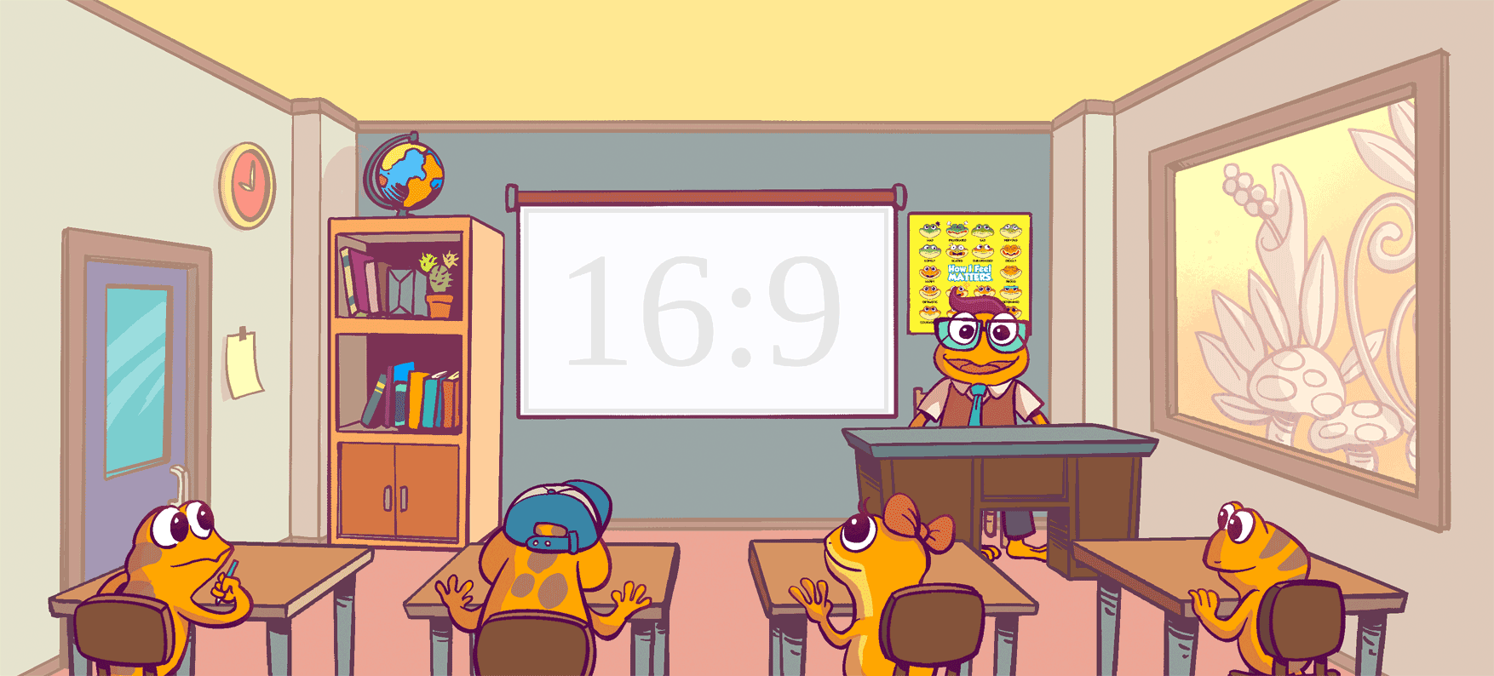
Choosing Orange - Feeling Better – Spreading Orange (p. 13-18)
Notes:
Presenter Notes: Click forward to automatically play The Orange Frog Kid’s book. Click forward once more to view the video in full screen.

Slide 6
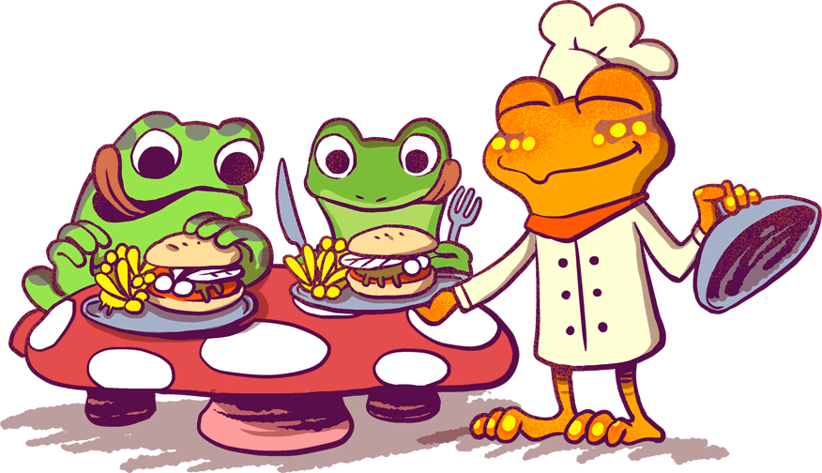
Thoughts
We start by hearing that Spark has made the decision to be Orange. When Spark is happier, he becomes more Orange. The happier he becomes, the more Orange he becomes. When he is helping others, or taking care of himself, he becomes a healthier, happier version of himself.

Slide 7
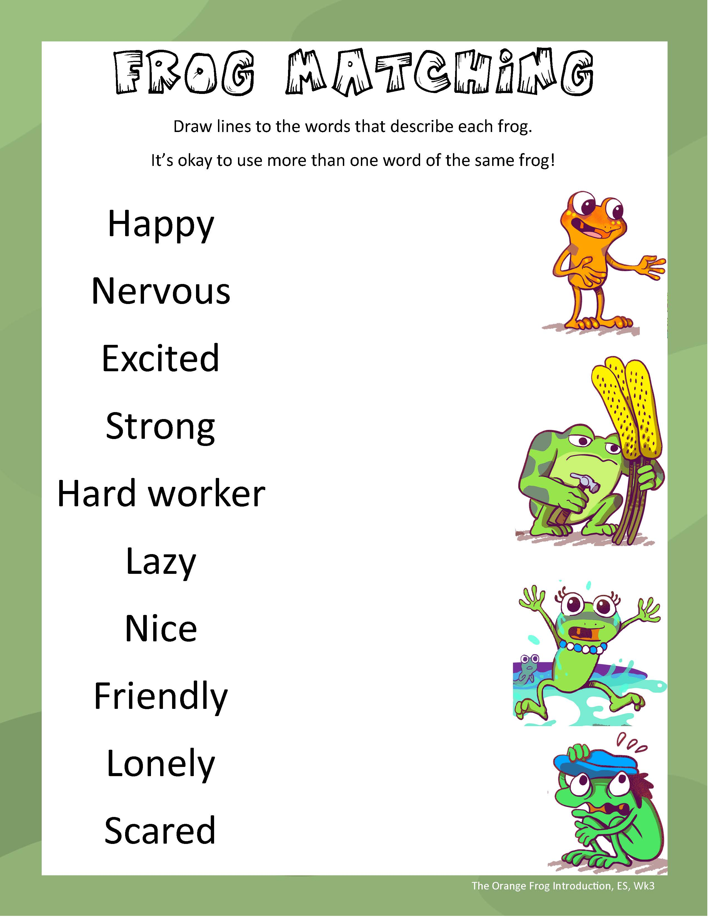
Activity
Let’s look at some images. We are going to match the frog (Spark, Misty, Bull, or Plop) with the word that best describes them.
It’s okay to use more than one word for the same frog and you can use the same word for more than one frog.

Slide 8
Happy
Excited
Nervous
Nice
Lazy
Strong
Scared
Hard worker
Friendly
Lonely
Notes:
ANSWER KEY
Spark: Happy, Friendly
Bull: Strong, Hard worker
Misty: Excited, Nice
Plop: Nervous, Lazy, Scared, Lonely

Slide 9
Questions
Why is Plop afraid to be friends with Spark?
Why did Bull develop an Orange spot?
What lesson did Misty learn by working at the Fly by Night restaurant?

Slide 10
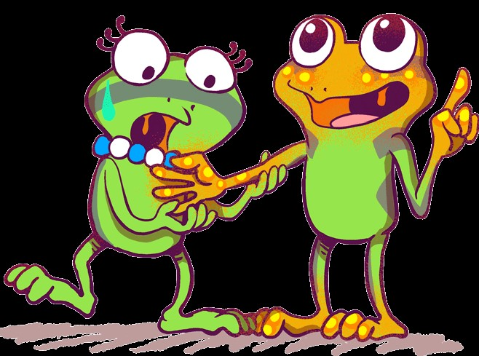
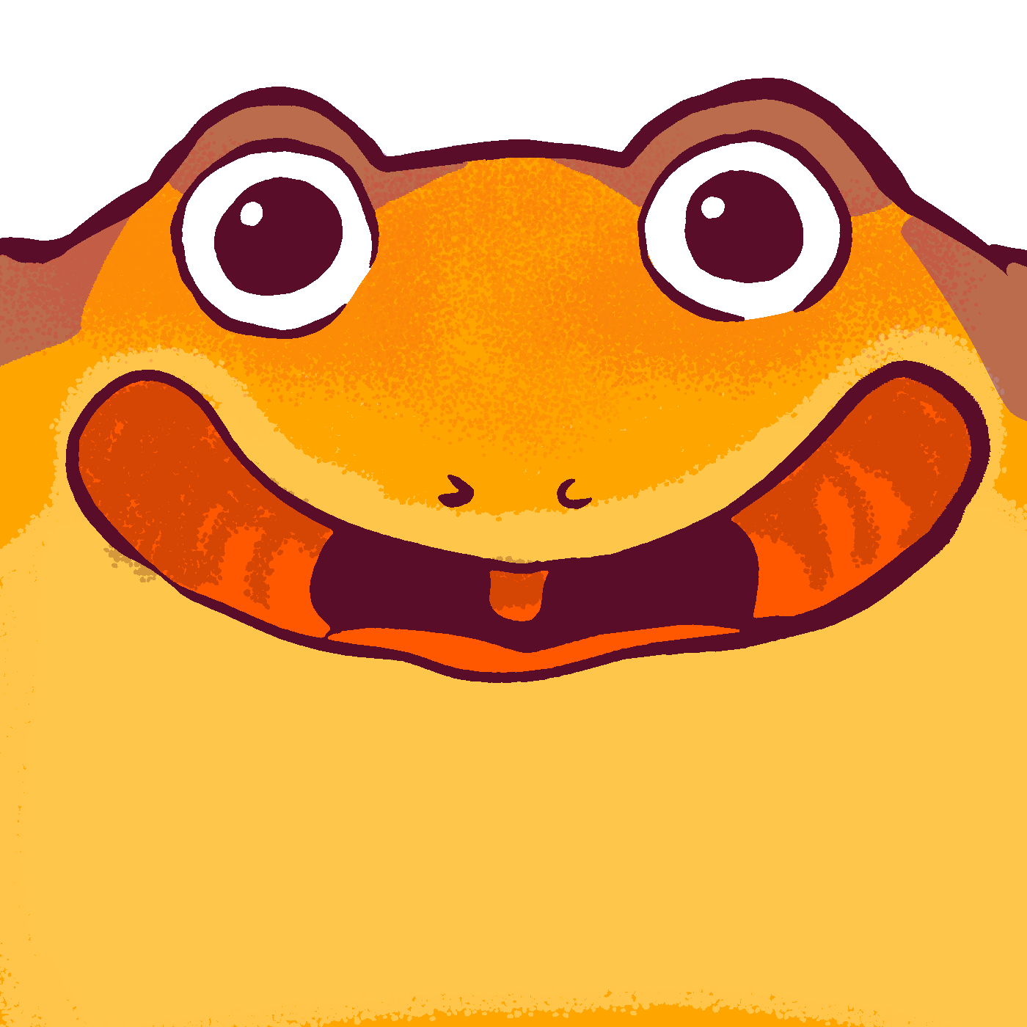
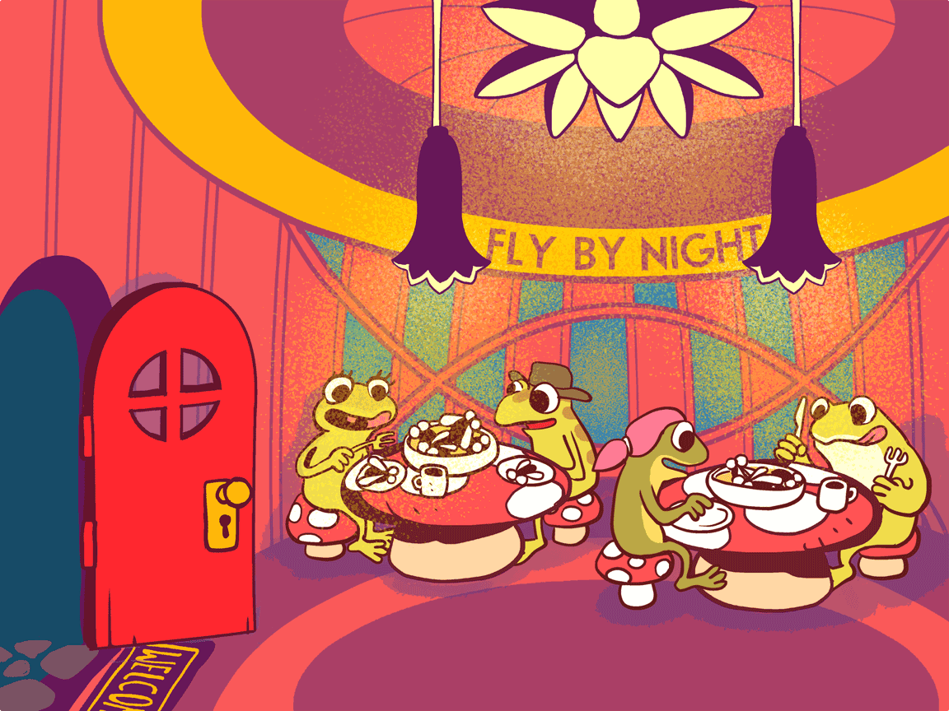
BONUS
What happened as Spark became more Orange?
Why did Spark choose to become more Orange?
How did Spark’s decision to become Orange impact those around him?

